Slide 1

Mastering Power Query:
Advanced Techniques in Excel
OPTIMIZING DATA ANALYSIS AND INTEGRATION
Presented by
Bipin
1071

Slide 2
INTRODUCTION
What is power query?
Power Query is a data transformation and data preparation tool that is part of Microsoft Excel. It is designed to help users connect to various data sources, extract data, transform it, and then load it into Excel for analysis. Power Query simplifies the process of cleaning and reshaping data, making it more suitable for use in Excel spreadsheets.

Slide 3
HERE IS THE DOCKET YOU ARE LOOKING FOR…
Merging and Appending Data Sources
Conditional Columns & Unpivoting data
Grouping the data
Error handling
Functions
Efficiency Hacks
Conclusion

Slide 4
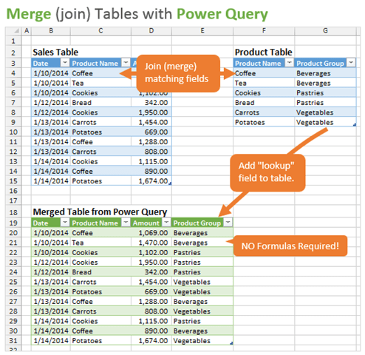
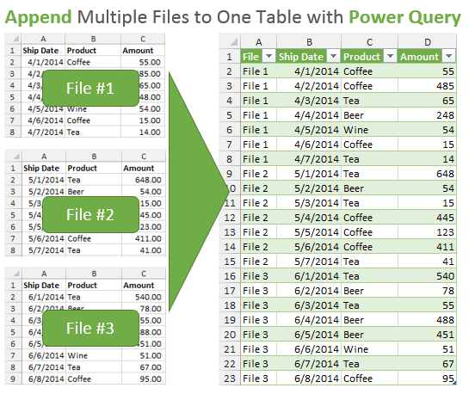
Merging and Appending Data Sources

Slide 5

Benefits
Merging
Appending
Relate data
Data enrichment
Data cleansing
Data consolidation
Combine similar data
Time-series data
Data aggregation
Helps in various analysis

Slide 6
Unpivoting the data
It’s basically a 3-step process:
Load your data into Power Query (create a query)
Unpivot the selected columns to normalize the data.
Output the results to a new worksheet in Excel.

Slide 7
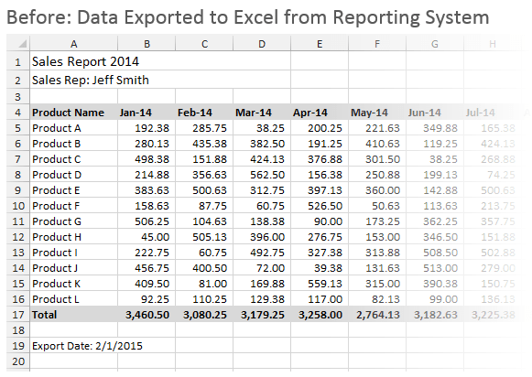
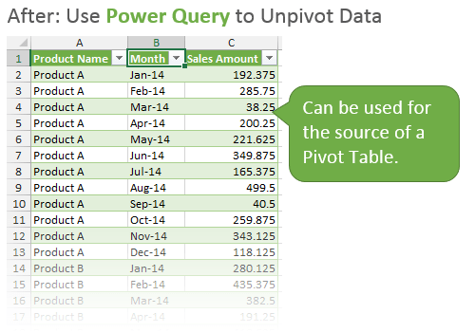
.

Slide 8
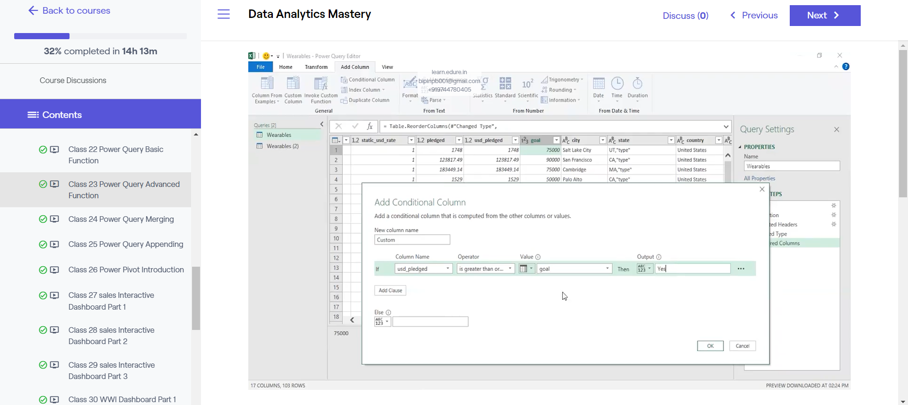
Conditional Columns
allow you to create new columns based on specific conditions within your data.
“Advanced data transformation technique”

Slide 9
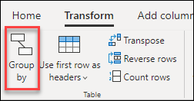
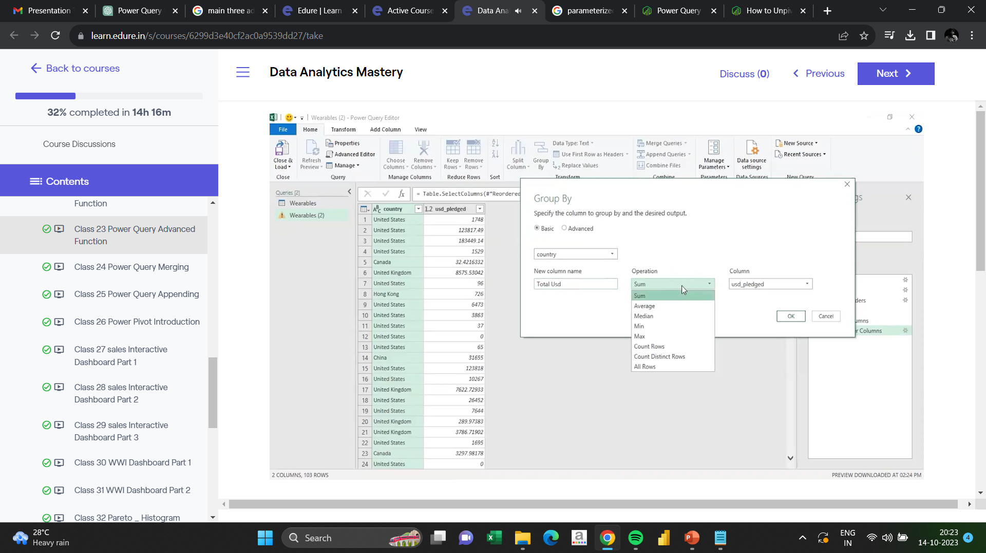
Grouping the data
Summarizing data effectively

Slide 10
Error Handling
Error handling in Power Query is a critical aspect of data transformation and analysis. It helps ensure data quality, data consistency, and smooth data processing.
Data QA
Data reliability
Data cleanup
Automated error handling

Slide 11

FUNCTIONS

Slide 12
Functions in Power Query
A function is a predefined formula that performs calculations using specific values in a particular order. Excel includes many common functions that can be used to quickly find the
Sum
Average
Count
Maximum value
Minimum value , for a range of cells

Slide 13
Common functions
Sum = sum(Select range)
Sumif = sumif (range, criteria, sumrange)
Average = Average ( select range)
Averageif = Averageif (range, criteria, average range)
Count = Count (select range) {Only Number}
CountA = CountA (select range) {Only Text}
Minimum = Min (select range)
Maximum = Max (select range)

Slide 14
Logical Functions
If = if(logical test, if true, if false)
And = and(logical test 1, logical test 2...)
Or = or(logical test 1, logical test 2, ...)
If error = if error(value, error value)

Slide 15
Date & Time Functions
Today = today()
Now = now()
Month = text (value,”Mmmm”)
Day = text(value,”Dddd”)

Slide 16
String Function
Left = left(text, number of characters)
right = right(text, number of characters)
Search = search(find text, text)
Upper = upper(text)
Lower = lower(text)

Slide 17
Efficiency Hacks
Grouping Data: Use the "Group By" feature to aggregate data efficiently. This is particularly useful for summarizing and aggregating data.
Promote Headers: Use "Use First Row as Headers" to quickly convert the first row of data into column headers.
Column Headers: To rename columns quickly, double-click on the column name in the Query Editor and enter the new name.
Reorder Columns: Drag and drop columns in the Query Editor to reorder them.
Copy-Paste Data: You can copy and paste data from external sources directly into the Query Editor.
Load Settings: Configure your default load settings in the Query Options to save time during data import.

Slide 18
Conclusion
In conclusion, we've delved into the world of Power Query, exploring advanced techniques that can transform the way you work with data in Excel. You now possess the tools to supercharge your data manipulation and analysis capabilities.
As we wrap up, remember that mastering Power Query is not just about the technical skills but about unlocking the potential of your data. It's about saving time, reducing errors, and gaining insights that can drive better decision-making.
But knowledge alone is not enough; it's the application that counts . . .

Slide 19





Slide 20



Start Applying What You've Learned :
Don't wait.Put these advanced techniques to excel you next data project.Experiment, refine and perfect you skills.

Slide 21

Keep Learning :
The world of data is constantly evolving.Stay curious and open to the new features and functions that power query to offer.

Slide 22




Seek Support and Resources :
whether its online or offline consultation,there are numerous resources available here.Use them to your advantage.

Slide 23



Seek Support and Resources :
Share Your Knowledge
As you become proficient, consider sharing your expertise to others.Teaching is one of the best ways to solidity your understanding.

Slide 24

THANK YOU

